Slide 1
Clinic management system “Project 3” Group members: Eman Atef Shahenda shaghlom Aya essam Tasabih farid

Slide 2
Overview:
2
The Clinic Management System project is designed to develop a structured and integrated database that streamlines essential operations within a medical clinic. It focuses on key areas such as scheduling patient appointments, maintaining medical records, managing clinic data and resources, and monitoring doctor availability. The system aims to overcome common challenges like appointment overlaps, inaccurate documentation, and reliance on paper-based records. By implementing a centralized database, patient information becomes more accessible and reliable, ultimately enhancing the efficiency and quality of healthcare services.

Slide 3
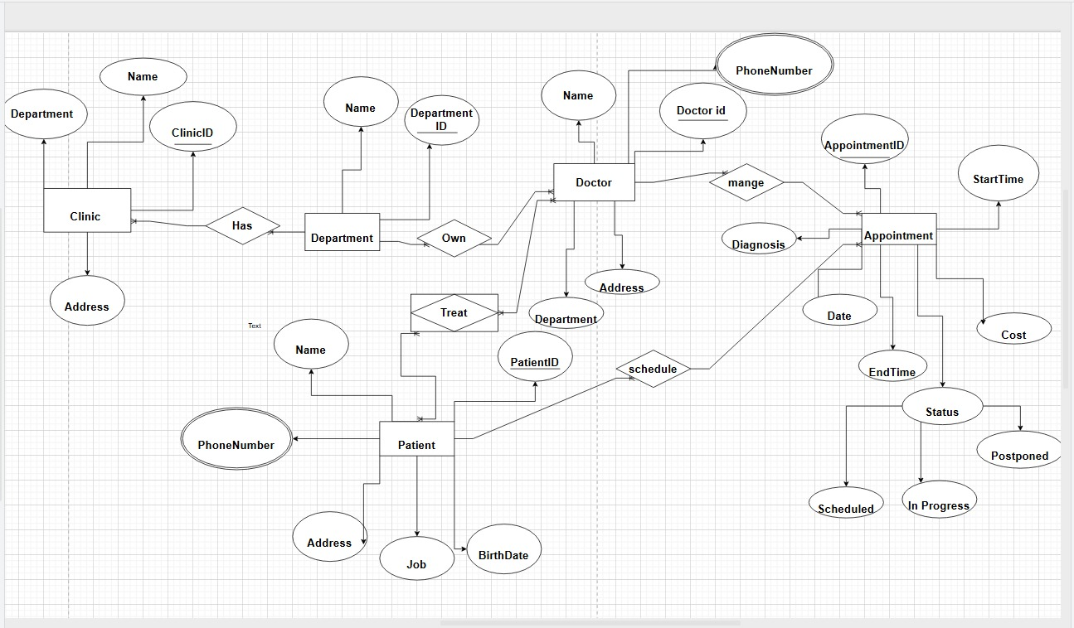
First step:ER Diagram

Slide 4
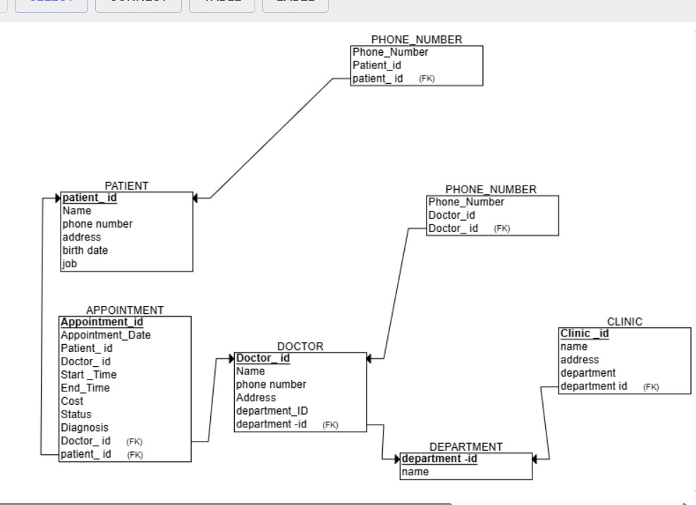
Second step: relational schema
4

Slide 5
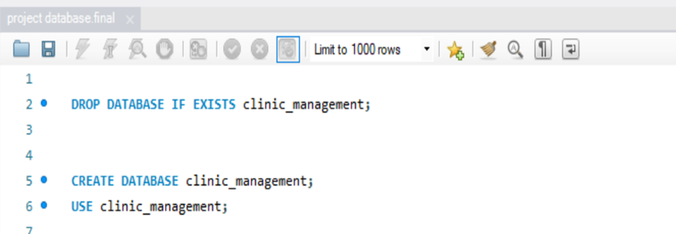
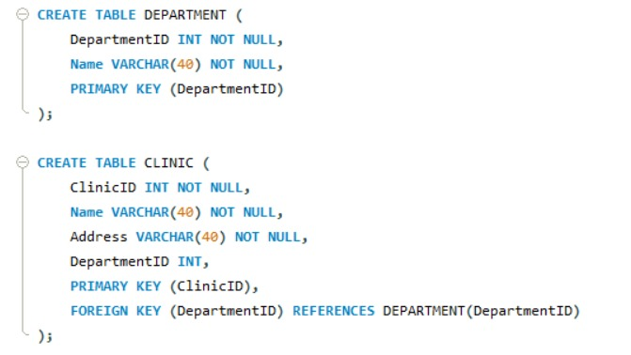
Third step: SQL code

Slide 6
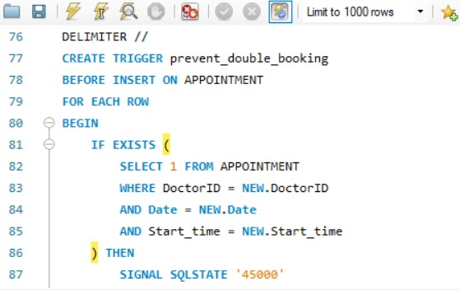
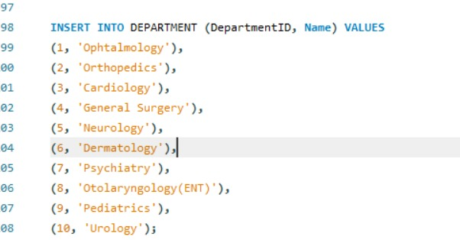

Slide 7
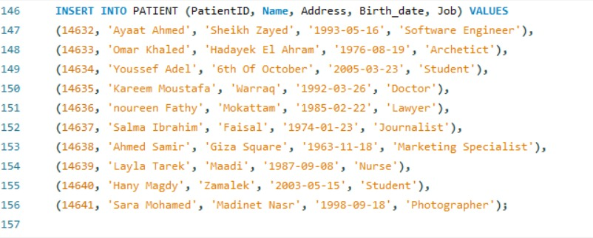
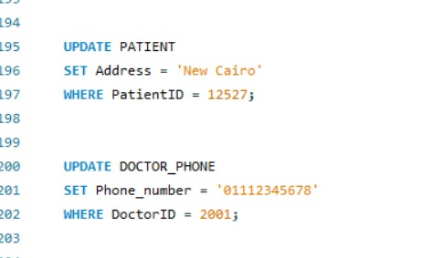

Slide 8
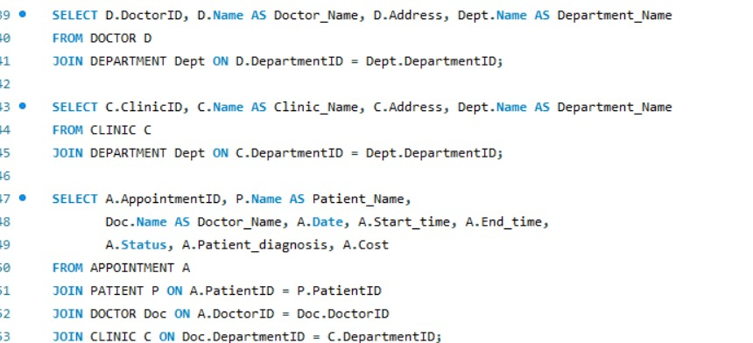
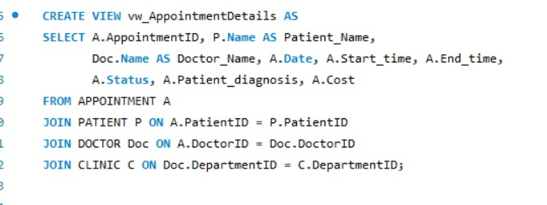

Slide 9
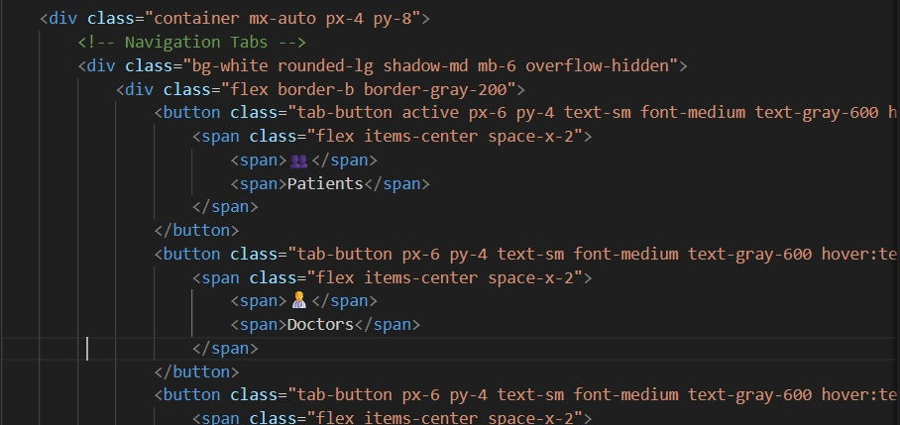
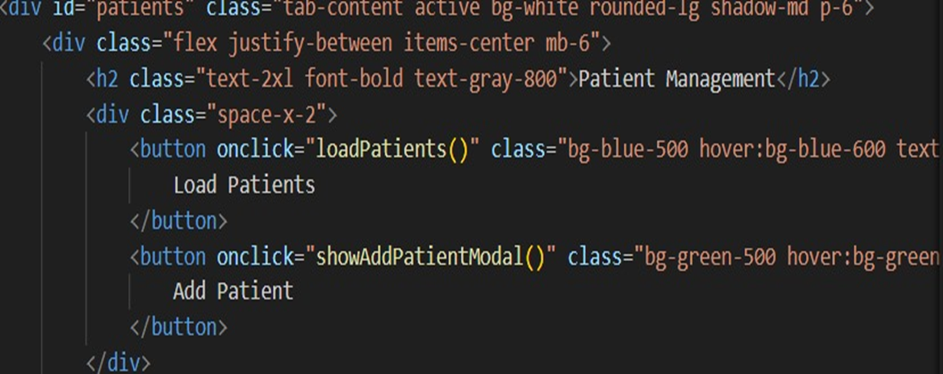
Fourth step: the bonus (GUI)

Slide 10
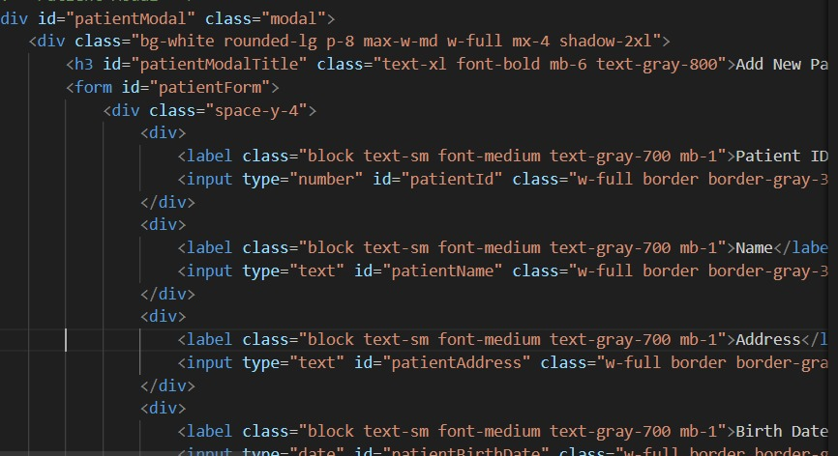

Slide 11
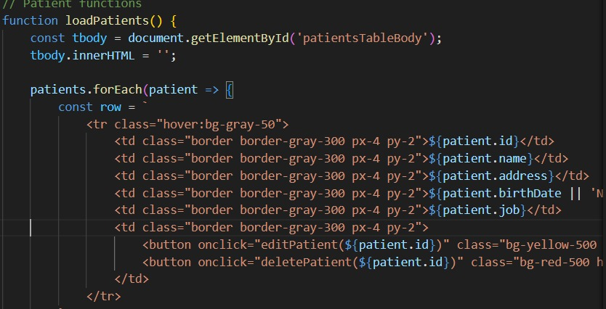

Slide 12
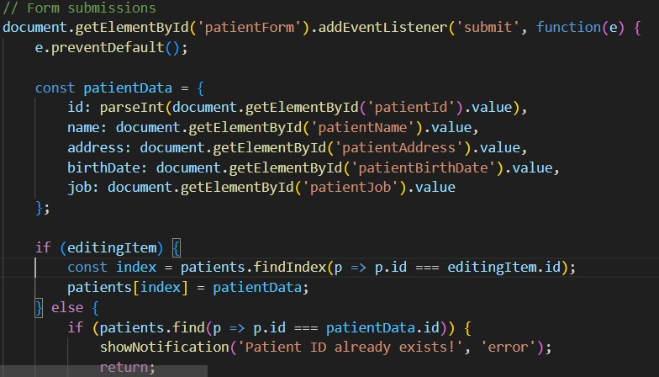

Slide 13
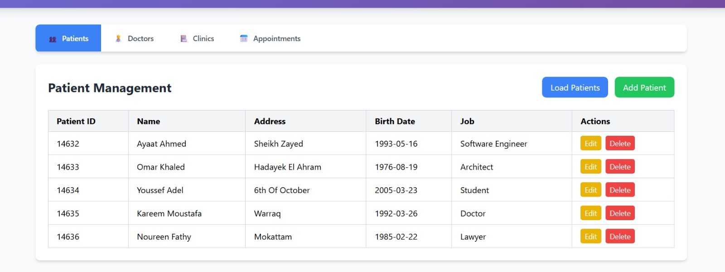
The final view: Patient Records

Slide 14
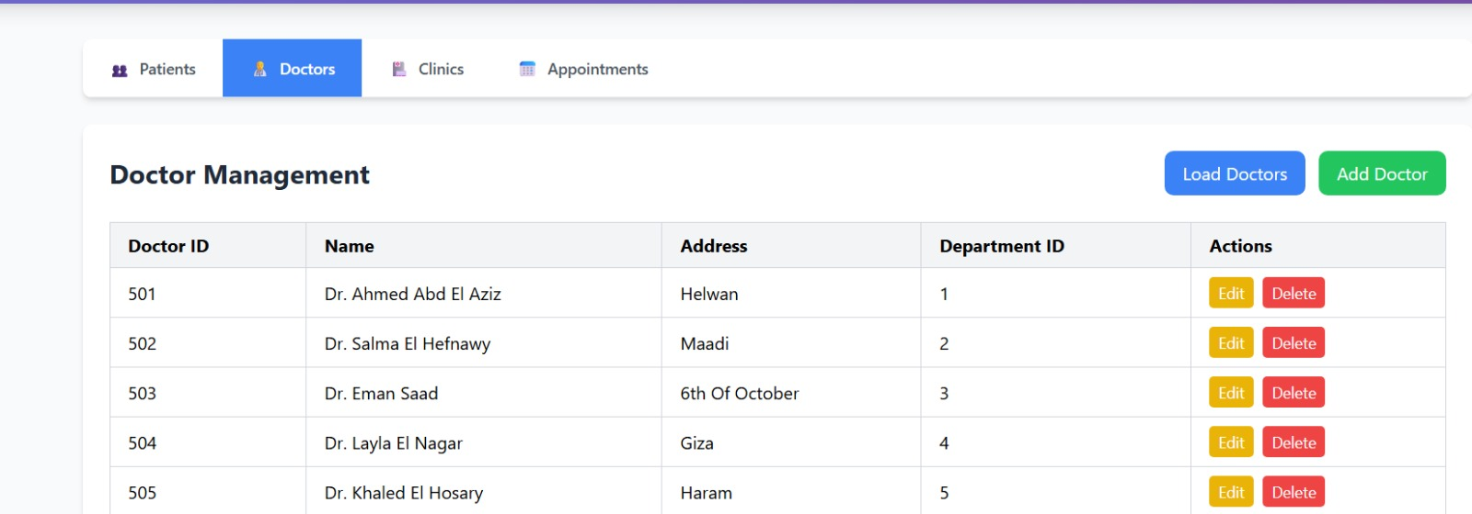
Doctor’s records

Slide 15
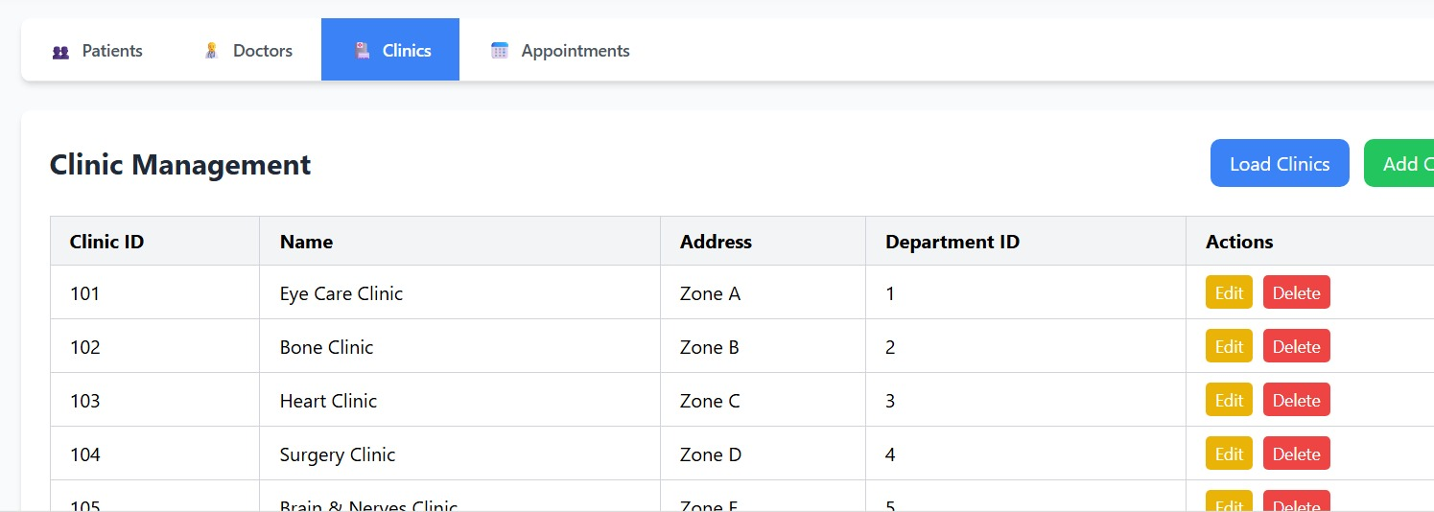
Clinics Records

Slide 16
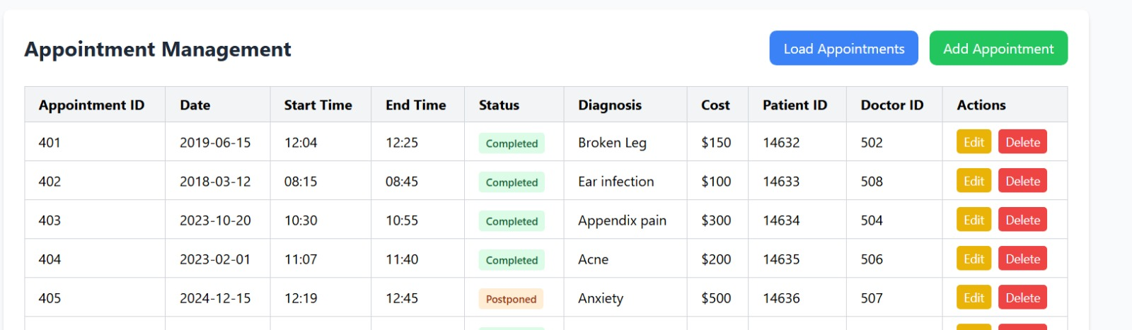
Appointments records

Slide 17
Thank You

